Slide 1
Employee Management System
Harshit Carpenter
16 August 2023

Slide 2
Introduction
The program allows users to perform basic CRUD (Create, Read, Update, Delete) operations on a list of employees. This system is particularly useful for small businesses or teams to manage employee information efficiently.

Slide 3
Features
The code provides the following features:
Add Employee
Delete Employee
Show Employee
Update Employee
Exit

Slide 4
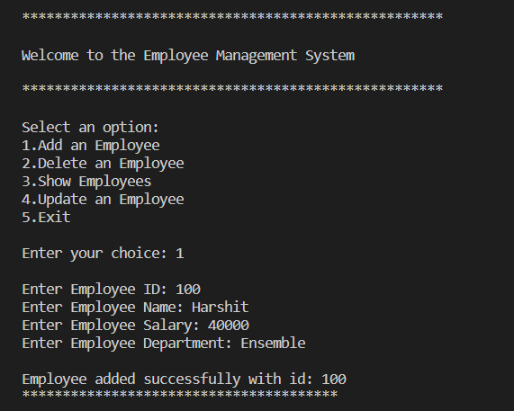
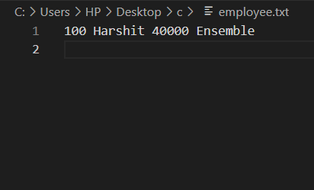
Adding employee

Slide 5
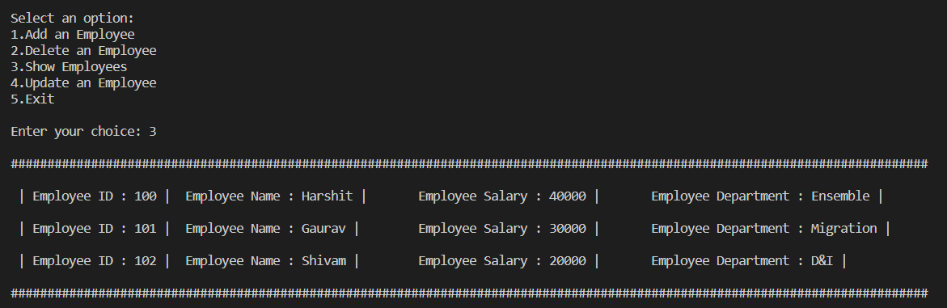
Showing employee

Slide 6
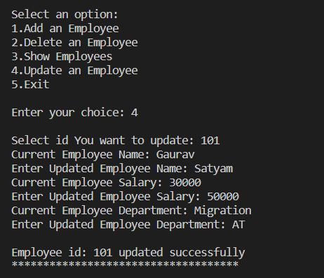
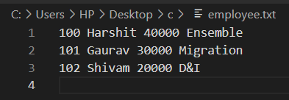
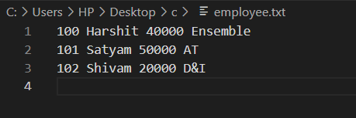
Updating employee

Slide 7
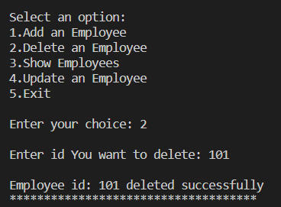
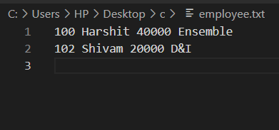
Deleting employee

Slide 8
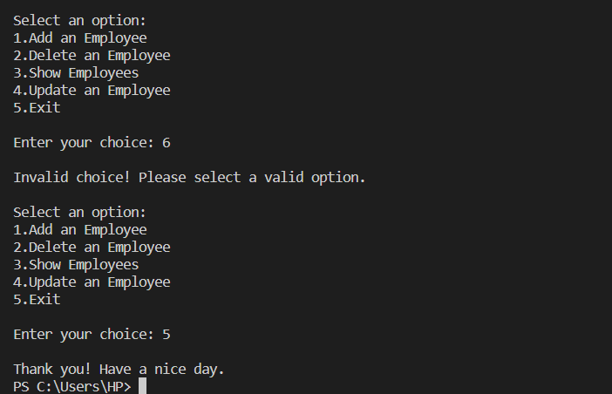
Ending the code

Slide 9
THANK YOU !

